Slide 1
Introduction to R
Part 1

Slide 2
First Note:
I am not an expert at R.
I’ve been hiking up the learning curve for about a year.
You can learn R.
You will get frustrated.
You will get errors that don’t help or make sense.

Slide 3
First Note:
Google is your friend.
Try googling the specific error message first.
Not the NaN one though, because ugh.
Then try googling your specific function and the error.
Try a bunch of different search terms.

Slide 4
First Note:
Helpful websites:
Quick-R: www.statmethods.net
R documentation: www.rdocumentation.org
TryR: tryr.codeschool.com
Swirl: www.swirlstats.com
Stack Overflow: www.stackoverflow.com

Slide 5
First Note:
Helpful text (for statistics):
Andy Field’s Discovering Statistics in R
Daniel Navarro Learning Statistics in R
This book is free online!

Slide 6
Get R
Download R from a CRAN mirror
http://cran.r-project.org/
Note:
Mac users will also need Quartz for plotting

Slide 7
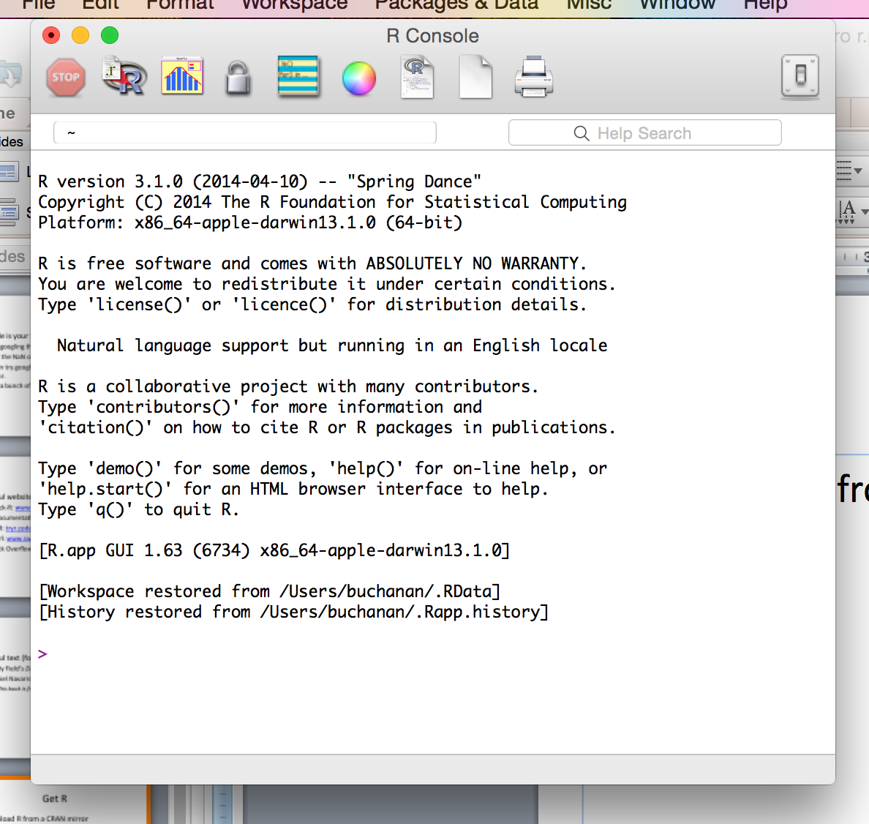

Slide 8
Get RStudio
For the love of sanity RStudio:
http://www.rstudio.org/

Slide 9
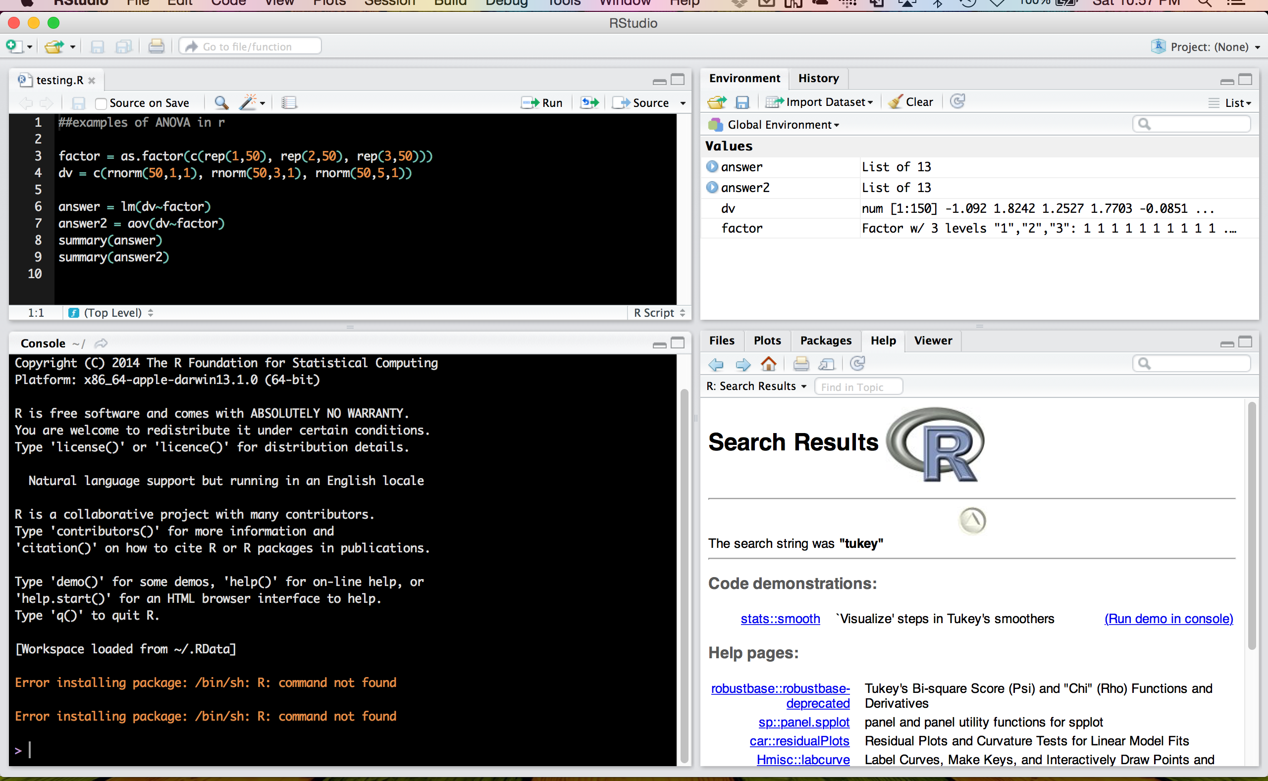

Slide 10
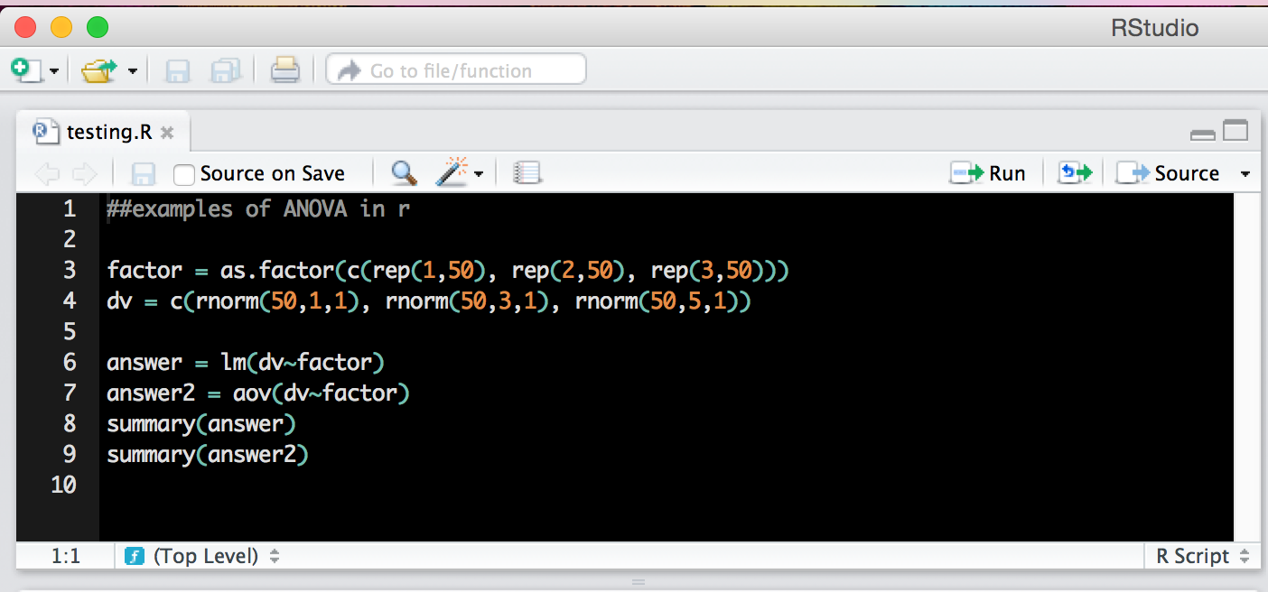
Top left window
Scripting window – these files end with .R extension.

Slide 11
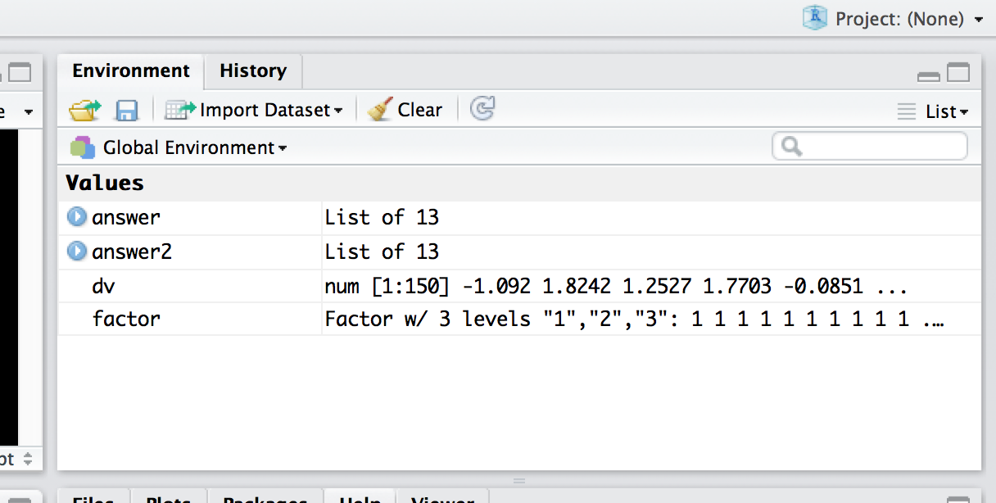
Top right window
Environment window – you can save the environment (variables, scripts, console) as
.Rdata files.

Slide 12
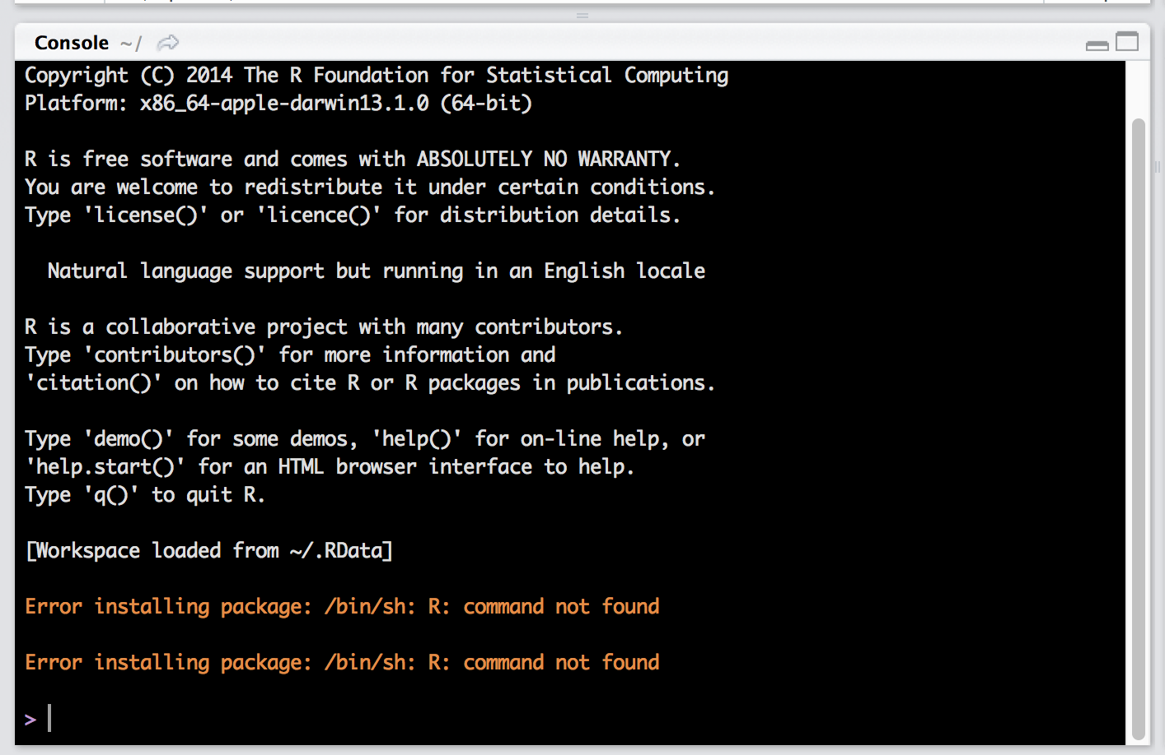
Bottom left window

Slide 13
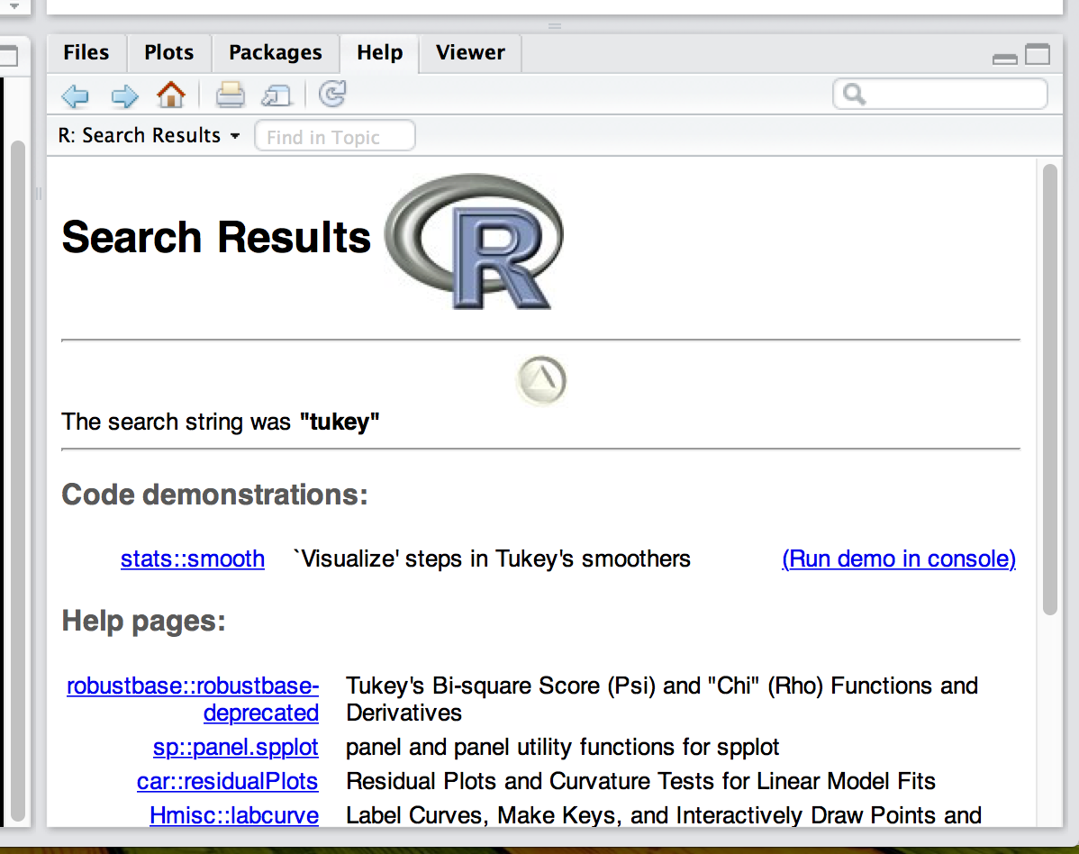
Bottom right window

Slide 14
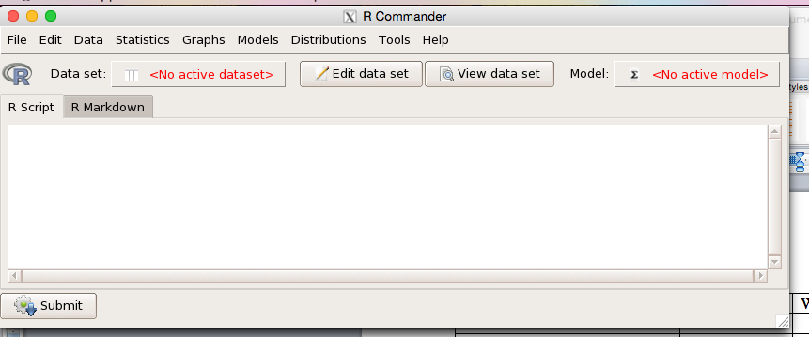
Get Rcommander!
Once we talk about how to install packages, we will add Rcommander:

Slide 15
Commands
Commands are the code that you tell R to do for you.
They can be very simple.
They can be very complex.
A note: R only does what you tell it. So when you encounter a mistake, it may be a typo or it may be an error in what you coded.

Slide 16
Commands
Commands can be typed in two places in RStudio.
At the top in an open R document.
Directly in the R console.

Slide 17
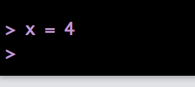
Commands
Try something simple in the console:
X = 4
What are the > signs?
Those indicate what has been run and a > with the cursor indicates it’s ready for the next command.

Slide 18
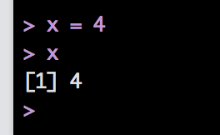
Commands
Now type X in the console (cApItAliZing matters!).
Now it shows you the value(s) of X.
It’s only one number: 4.
What is that [1] thing?! (give me a minute).

Slide 19
Commands
Note:
= and <- are equivalent.
In Swirl use <- to get credit.
An important thought here:
The question in R is never “can R do this?” it’s “how can R do this?”
(Un)fortunately, the answer is often: about 10 different ways.

Slide 20
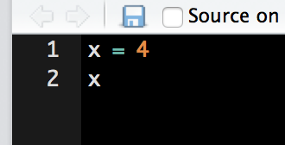
Commands
Now type the same thing into the R script window.
You should notice that nothing happened in the console.
The script window allows you to work on/save code without running it.

Slide 21
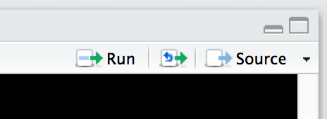
Commands
You can run the code by highlighting it and clicking on run or by hitting:
Windows: ctrl + r or ctrl + enter
Mac: command (apple) + return

Slide 22
Commands
The script window is great for saving projects so you can remember and recreate your steps when you need to later.
No need to save multiple files! ;)

Slide 23
Commands
Two console shortcuts:
Hit the up arrow – you can scroll through the last commands that were run.
Hit the tab key – you’ll get a list of variable names and options to select from.

Slide 24
Commands
So why RStudio?
SPSS is very visual, but R is not. You can certainly view the output and the data you are using, but if you don’t remember the variable names, it can be very daunting.
The top right window is your friend.

Slide 25
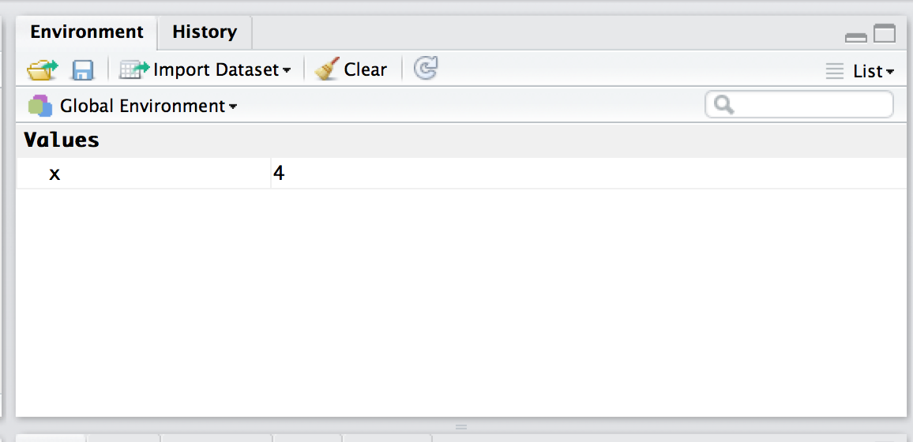
Commands
Anytime you create/use a variable, it will appear in the environment window.
You should have an X in that window now.

Slide 26
Commands
The environment window also allows you to see all the types of the variables you have open.
I find this very handy for lists and dataframes, which can be difficult to remember what all is stored in them.

Slide 27
Object Types
Vectors
Lists
Matrices
Data Frames

Slide 28
Object Types
Within these objects, values can be:
Character
Numeric/Integer/Complex
Logical
NaN (versus NA)

Slide 29
Object Types
And furthermore, within objects you can have attributes
The most important that you’ll use are their names
Example:
After you run a regression, you can get a variable that has the residuals and coefficients stored. They are stored with specific names, so you can call them.

Slide 30
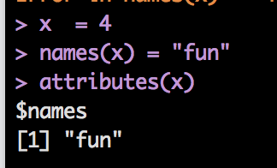
Object Types
Example
attributes(OBJECT NAME)

Slide 31
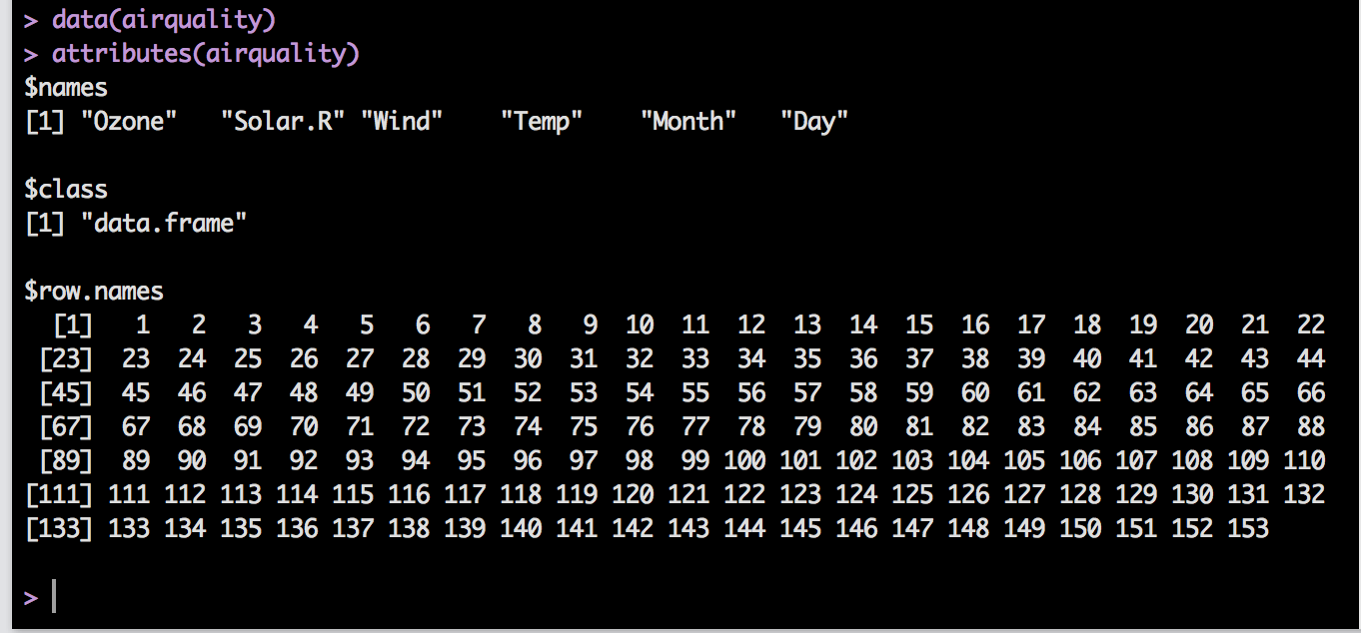
Object Types

Slide 32
Object Types
Another way to see what’s going on with an object:
ls(OBJECT NAME)
LS gives you a list of the names in an object.
str(OBJECT NAME)
STR gives you the structure of an object, which is helpful to know what things are stored in that object.
It’s the same thing you can see in the environment window.

Slide 33
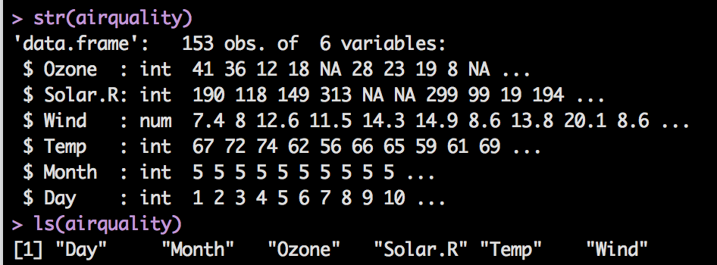
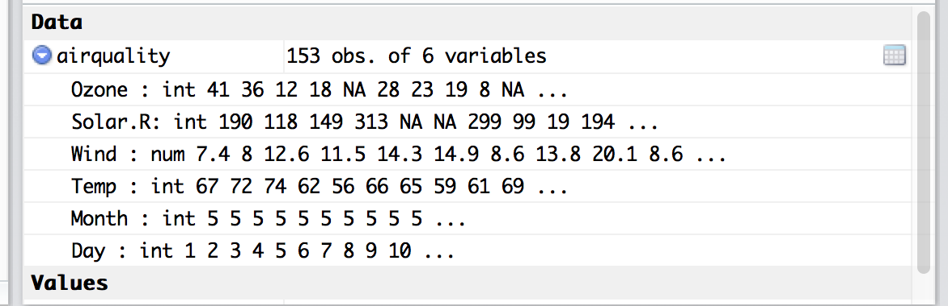
Object Types

Slide 34
Object Types
Vectors
You can think about a vector as one row or column of data
All the objects must be the same class/type (number, logical, etc.).
If you try to mix and match, it will coerce them into the same type or make them NA if not.
Think about: SPSS does this with characters as well.

Slide 35
Object Types
Let’s make a vector.
You’ve already done that! Go you!
X = 4, makes a vector.
X
That vector has one value (hence the [1] when you print it out) and is a class type numeric.

Slide 36
Object Types
Let’s make some more vectors! Learn four new things:
A = 1:20
B = seq(1, 20, 2)
C = c(“cheese”, “is”, “great”)
D = rep(1,30)

Slide 37
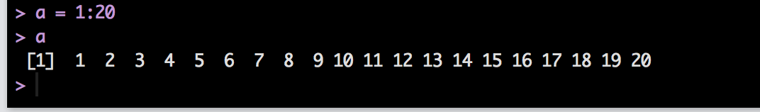
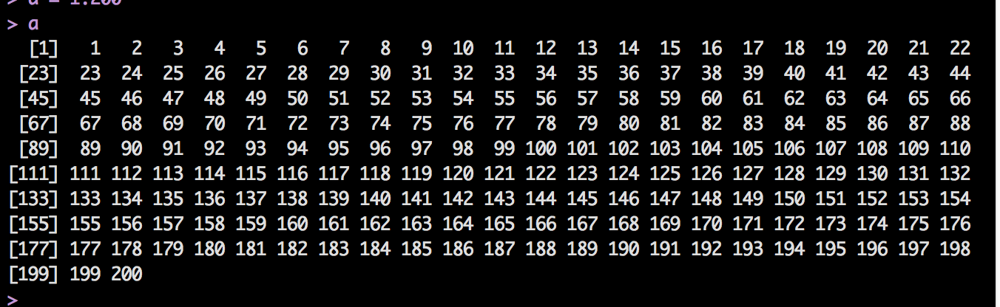
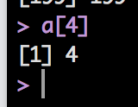
Notice you got a sequence of 20 numbers with intervals of 1.
The [1] doesn’t mean 1 row of data, it means here’s item number 1.
Try a = 1:200.
Now you see that the [] corresponds to the item placement in the vector.
Try typing a[4].

Slide 38
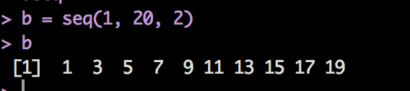
The sequence function works in the following way:
Seq(start, end, by)
Start at the number 1
End at the number 20
Increment by 2

Slide 39
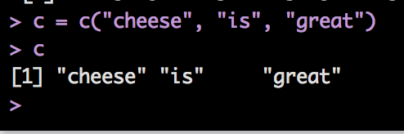
The c function = concatenate or combine.
This function lets you combine things into one vector.

Slide 40
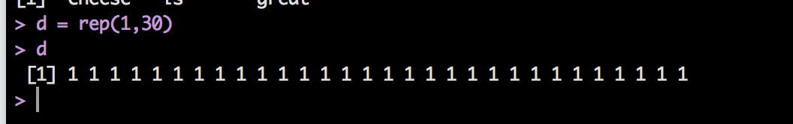
The rep function lets you repeat an object over and over.
rep(repeat this, so many times)
Try rep(1:4, 10)
You can combine all of these functions to get the exact sequences you need.

Slide 41
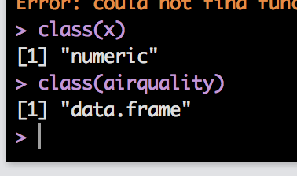
Object Types
Some things to try with vectors:
class(OBJECT NAME) – tells you the type of data stored or the type of object if you are working with things bigger than vectors.

Slide 42
Object Types
Some things to try with vectors:
length(OBJECT NAME): tells you the number of things in that object.
That can be tricky though – the length of a vector is the number of objects, but the length of a list/data frame is the number of things in a list, not the number of items of each sub variable.
I.E. it’s kind of like the number of columns in SPSS, not the number of participants.

Slide 43
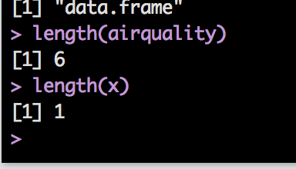

Slide 44
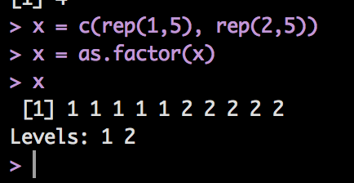
Object Types
Factors
Remember dummy coding in SPSS?
R does it for you! Yeah!
Use the as.factor(OBJECT NAME) command.
Let’s make a vector:
X = c(rep(1,5), rep(2,5))
X = as.factor(X)
You can also use text.

Slide 45
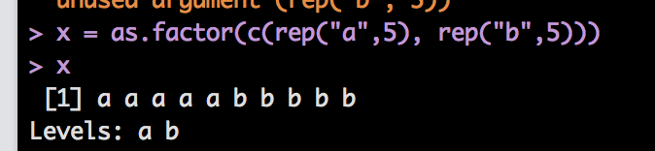
Object Types

Slide 46
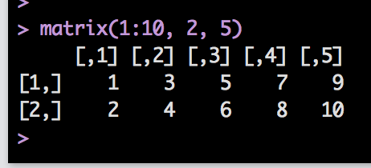
Object Types
Matrices
Matrices are vectors with dimensions (like a 2X3).
You can create a matrix with the following:
matrix(things to put into the matrix, rows, columns)
matrix(1:10, 2,5)
Notice it filled in the numbers going down.

Slide 47
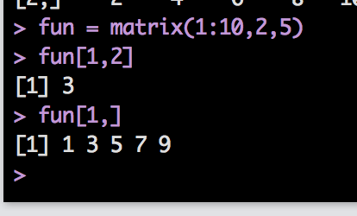
Object Types
Now what are the [,1] and [1,]?
Matrices are called by listing [row, column]
If you all one row or all one column:
fun[1, ]
Leave the indicator blank, and it will assume you want ALL of them.

Slide 48
Object Types
What if I want to combine things?
You can’t use c(row, row) – c is for vectors because there’s only one row.
You can use:
cbind(column, column)
rbind(row, row)
Let’s combine two vectors:

Slide 49
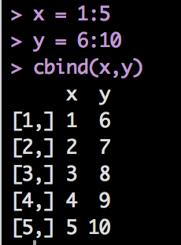
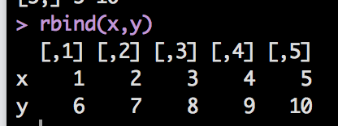
Object Types
X = c(1:5) (note x = 1:5 is the same thing)
Y = c(6:10)
cbind(x,y)
rbind(x,y)

Slide 50
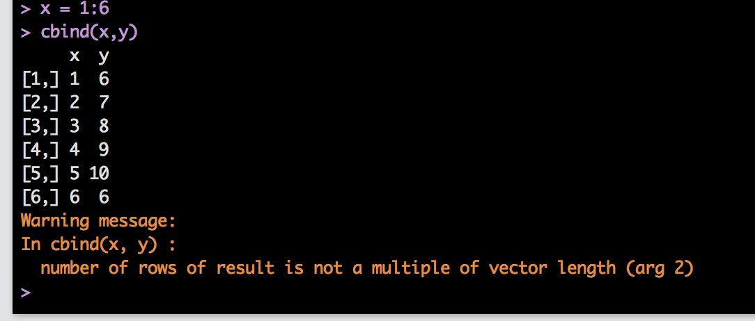
Object Types
Be careful when the objects are not the same length:

Slide 51
Object Types
Matrices are like vectors, everything must be of the same class/type (all numeric, all character, etc.)

Slide 52
Object Types
Data Frames are your friend
We will use these the most often.
They are special matrices, where everything must be the same length.
BUT the columns can be different classes.
So you can have characters, logicals, and numbers all together.

Slide 53
Object Types
Before talking about how to call values in a data frame, let’s talk about lists.
Lists are vectors that allow you to have different classes/types.
Lists are handy because they allow you to have different lengths of groups, unlike data frames.
You can create them with the list() function.

Slide 54
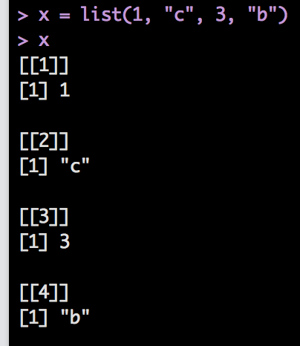
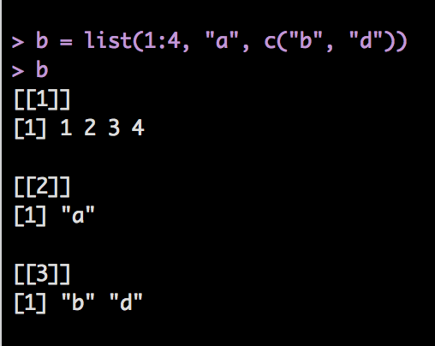
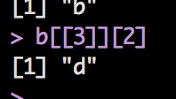
What’s with the [[]]?
[[]] indicates which number of the list the smaller vector is, while [] indicate which item in that smaller vector.
Try getting d out of the b list:

Slide 55
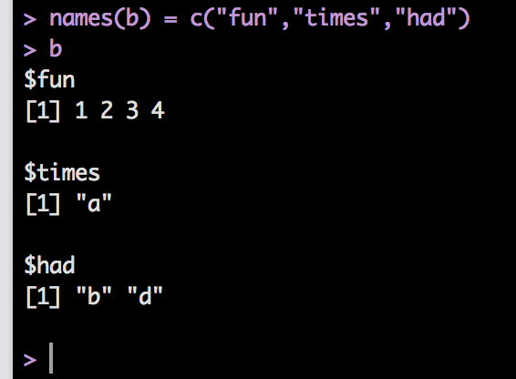
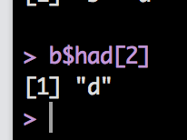
Object Types
Lists can also have names:
names(b) = c(“fun”, “times”, “had”)
Now try to get d out:

Slide 56
Object Types
Why even talk about lists when most of our data is going to be data frames?
When you save data from a function (like anova or regression), you will often get all the information from that function as a list.
It really helps to know how the heck to get the piece of information you need – especially when it’s not provided automatically with the summary function.

Slide 57
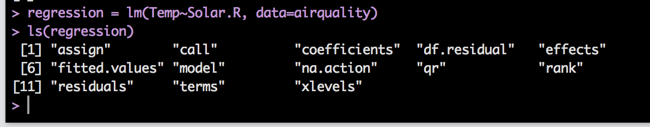
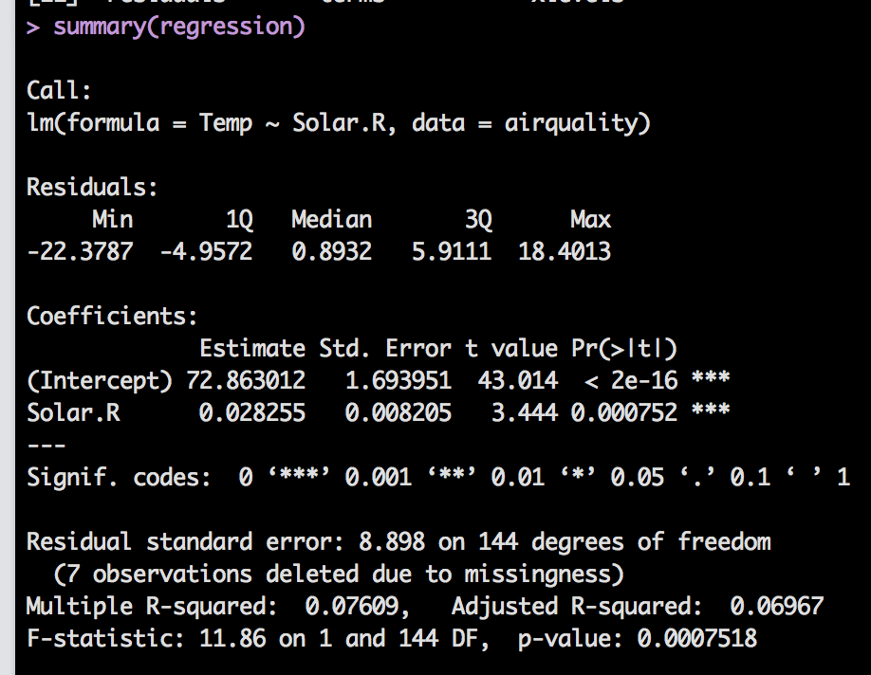
A quick example:

Slide 58
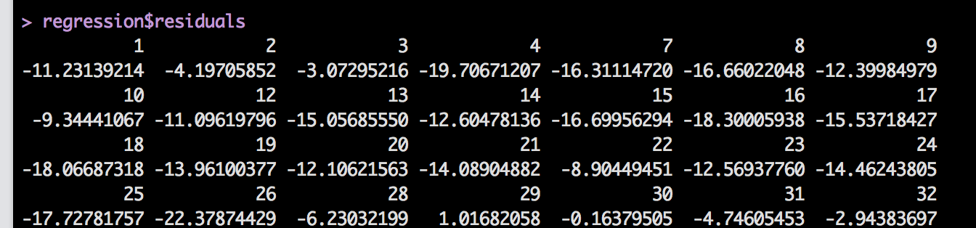
So what if you wanted the residuals?

Slide 59
Object Types
Now what is up with the $?
Lists and data frames are dimensional, so you can use the following to find something:
Lists: [[number]][number]
DF: [row, column]

Slide 60
Object Types
That’s tedious.
If they have names, you can use the $ to indicate the column (or sub-vector) name.
Therefore:
airquality$Temp and airquality[,4] are the same thing.

Slide 61
Object Types
REMEMBER:
Just because you know that the airquality dataset is open and Temp is a variable, doesn’t mean that R cares.
You must specify what object to look at for the Temp piece.

Slide 62
Object Types
You can also do the following:
with(OBJECT NAME, THING YOU WANT TO DO)
With applies the data frame/list name to all the variables you are using. It basically says “hey the stuff they want you to use is HERE”.
attach(OBJECT NAME)
Attach does the same thing, but it’s more permanent. It leaves that object open the whole time.
This version can get tricky if you have multiple things with the same name you are trying to use.

Slide 63
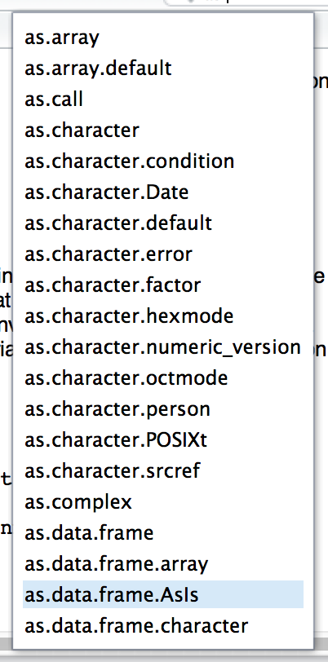
Object Types
Let’s say you want to change from one type to another:
as.data.frame
as.numeric
as.factor
as.logical
Etc.

Slide 64
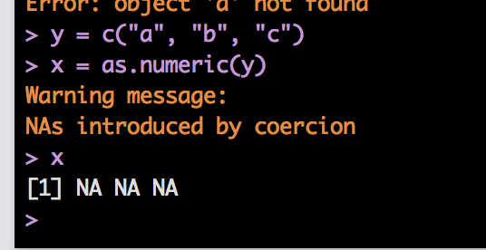
Object Types
Let’s make a character vector:
Y = c(“a”, “b”, “c”)
Try changing that to other types of data:
X = as.numeric(y)

Slide 65
Object Types
Summary: it’s good to understand types of objects, because it allows you to understand:
How to get to the information you need
Why you might be getting NaN or NA values
Etc.

Slide 66
Subsetting
Subsetting is pulling out the rows/columns that you need given some criteria.
We already talked about how to select one row/column with [1,] or [,1] and the $ operator.
What about cases you want to select based on scores, missing data, etc.?

Slide 67
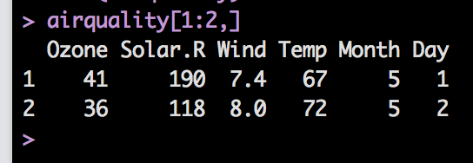
Subsetting
Examples
Let’s use the airquality dataset.
Pick out the first two rows of the whole dataset.
airquality[1:2,]
Remember that you can save each of these by setting them equal to a variable name.

Slide 68
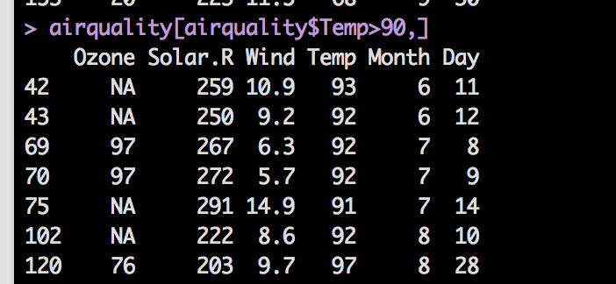
Subsetting
You can also use the logical operator to determine how to pick something.
Logical
airquality[airquality$Temp> 90,]

Slide 69
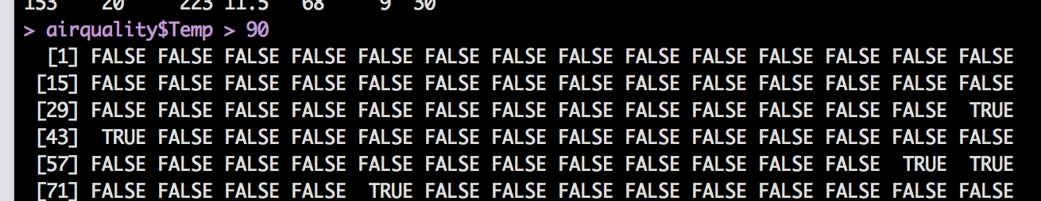
Subsetting
How does the logical operator work?
It analyzes each row/column for the appropriate logical question
So, in this example, we asked it to analyze the Temp column.
Each row was tested to see if it was greater than 90.
Try airquality$Temp > 90

Slide 70
Subsetting
Therefore, all the columns with TRUE were selected.
True = 1
False = 0
You can use this feature to your advantage when selecting for missing cases.

Slide 71
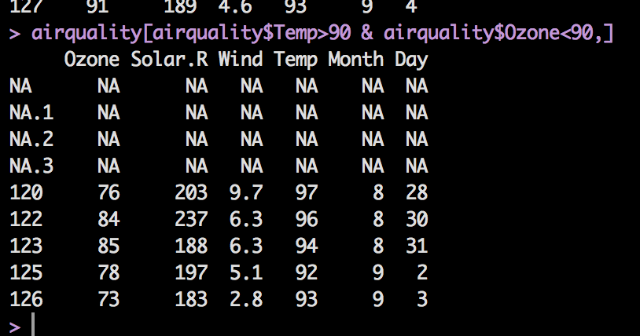
Subsetting
You can use multiple arguments to get the exact data you want.
airquality[airquality$Temp>90 & airquality$Ozone<90,]
You’ll still get NAs though, we’ll get to how to deal with them.

Slide 72
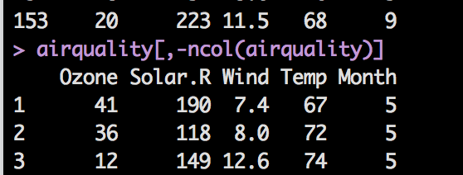
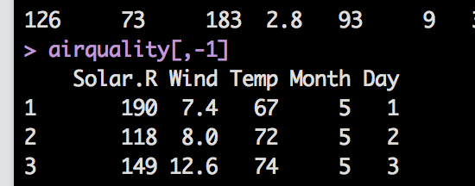
Subsetting
Let’s say you wanted everything BUT the first column
airquality[,-1]
Let’s say you wanted everything BUT the last column
airquality[,-ncol(airquality)]

Slide 73
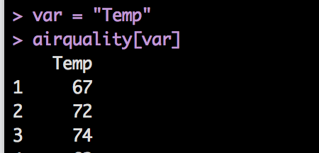
Subsetting
Something important:
When subsetting lists or dataframes, you can do this:
var = “Temp”
airquality[var]
airquality$Temp
But not:
airquality$var
When you use the $, an exact match is expected, but the [] will fill in with the variable value.

Slide 74
Subsetting
Another subsetting function is subset()
Subset requires
(data set name, logical function)
Optional includes what columns you want to select
subset(airquality, Temp > 80, select = c(Ozone, Temp))

Slide 75
Missing Values
Missing values are considered NAs
NaN is not a number, NA is a missing value.
However, NaN sometimes is the error when you get when you try to do something with a NA.
You sometimes can get away with having them in the dataset, often not.

Slide 76
Missing Values
Many functions have options that allow you to omit them to run the function.
Not all of them, and they often do the missing omission differently.

Slide 77
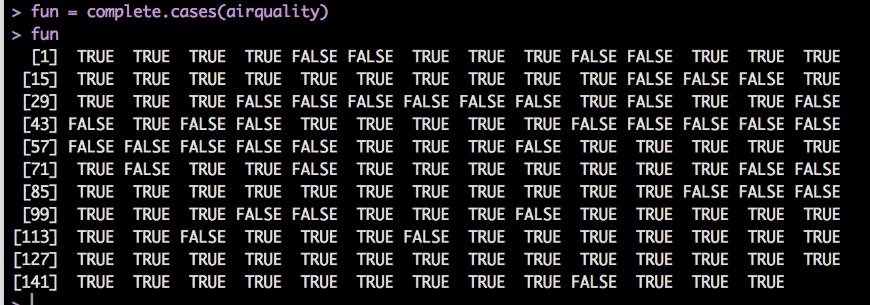
Missing Values
There are several NA functions:
But they often don’t do what you think.
complete.cases(DATA SET)

Slide 78
Missing Values
The missing values functions often return logical vectors with:
TRUE = yes missing data
FALSE = no missing data
Complete cases tells you if the entire row is complete.
TRUE = complete, FALSE = incomplete

Slide 79
Missing Values
Another function that is faster than complete cases is na.omit()
na.omit(airquality)

Slide 80
Missing Values
is.na() works in much the same way, but works in individual values, rather than the entire row like complete cases.
Usually, you can use this function for individual columns or rows.
Is.na can help with checking for missing values in data screening.

Slide 81
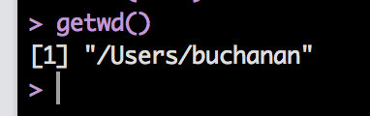
Working Directory
The working directory is where you are currently saving data in R.
What is the current working directory?
Type in getwd()
You’ll see the path for your directory
Note: I’m using a Mac.

Slide 82

Working Directory
How to set the working directory:
setwd(“PATH”)
If you aren’t really familiar or good with using PATH values, here’s a trick:

Slide 83


Working Directory
Now you can pick the folder you are interested in saving your files to.
Once you do that, the bottom right window will show you that folder.

Slide 84
Working Directory
Why is all this important?
You can use getwd and setwd in saved R scripts to point the analyses to specific files.
Basically, you can set it to import a file from a specific spot and use that over and over, rather than importing the file each time you open R.

Slide 85

Packages
Packages are add-ons to R that allow you to do different types of analyses, rather than code them yourself.
R comes with many pre-programming functions – lovingly called base R.
At the top of the help window, you can tell which package a function is included in.

Slide 86
Packages
Packages are checked/monitored by the CRAN people.
That means there’s some oversight to them.
Many other types of functions can be downloaded from GitHub.
Use at your own risk.

Slide 87
Packages
Note: each time R updates, the packages sometimes come with it, sometimes they don’t.
If you are looking for a specific package, and it doesn’t want to install the normal way (next couple slides), but you know it exists → google it and get the TAR/zip files.
You can install them from the TAR/zip files.

Slide 88
Packages
How to install:
Console: install.packages(“NAME OF PACKAGE”)
Let’s try it!
install.packages(“car”)
Note: you have to be connected to the internet for packages to install.

Slide 89

Packages
How to install:
Through RStudio
Click on packages, click on install.
Note: you can see here in this window what all you have installed, and if you click on them, you will load that help file (or click the check box to load them).

Slide 90

Packages
Start typing the name of the package – a drop down will appear with all the options.

Slide 91
Packages
Now it’s installed! Awesome!
That doesn’t mean that it loads every time.
Imagine this: if SPSS had a function that knew how to do regression, but it didn’t load every time.
Annoying!
But this saves computing power by not loading unless you need it.
You will run something without turning on the right package. It’s cool – all the cool kids do it.

Slide 92

Packages
Packages are also called libraries.
You can load them two ways:
In the console: library(car) (look no “” this time).
In the packages window by clicking on the check box.

Slide 93
Packages
I suggest adding the code to your script to load the packages you need to save yourself the headache of trying to remember which ones were important.

Slide 94
Working with Files
Data files (like the airquality dataset) come with base R.
You don’t technically have to load them, but you can get them to appear in environment window by:
data(SET NAME)

Slide 95
Working with Files
If you want to see what’s available, type data()
Use the help(DATA SET NAME) or ?DATA SET NAME to see what is included/is part of the data set.

Slide 96

Working with Files
Data files are not nearly as visual as Excel or SPSS ☹
But RStudio can give you somewhat of a visual.
Type View(airquality) to get a visual (note V is capital)
Or click on it in
environment window

Slide 97
Working with Files
You can import all types of files, including SPSS files.
I find .csv easiest but that’s me.
You can do .txt with any separator (comma, space, tab)

Slide 98


Working with Files
Import from Rstudio
Pick your file and click open

Slide 99

Working with Files

Slide 100
Working with Files
This process is the same as:
real_words <- read.csv(”FILE NAME")
The read.csv function – which has a lot more settings, but this process make it easy to start working with files.

Slide 101
Working with Files
You can also use the read.table function – which reads more than just csv files, allows you more flexibility in how you import the files.

Slide 102
Working with Files
Importing SPSS files.
You need the memisc package.
as.data.set(spss.system.file(SPSS DATA), use.value.labels=TRUE, to.data.frame=TRUE)
(you can also use Rcommander)

Slide 103
Working with Files
All of these options will import your data set as a data frame.

Slide 104

Working with Files
Clear the workspace
You don’t have to do this, but it helps if you want to start over. Click on clear in the environment window.
rm() and remove() functions do the same thing, but you have to type the object names.

Slide 105
Functions
Functions are pre-written code to help you run analyses (so you don’t have to do the math yourself!).
So there are functions for the mean, variance, z-tests, ANOVA, regression, etc.

Slide 106

Functions
How to get help on a function (or anything really)
?function/name/thing
Try ?lm

Slide 107

Functions
More help on functions:
help(function) – same as ?function
args(function) – tells you all the arguments that the function takes

Slide 108
Functions
What do you mean arguments?
Functions have a couple of parts
The name of the function – like lm, mean, var
The arguments – all the pieces inside the () that are required for the function to run.

Slide 109
Functions
Get help on functions:
example(function)
Gives you an example of the function in action.

Slide 110
Functions
Let’s write a very simple function to exponents.
You do have to save them, set them equal to something.
pizza = function(x) { x^2 }
You can make more complex function, adding more to the (x) part like (x,y,z).
The variables can be named anything, they just have to match in () and within the {}.

Slide 111

Functions
pizza = function(x) { x^2 }
This part is called the formal argument – that’s where you define the function.
pizza(2)
The actual argument – that’s where you call the function and use it.

Slide 112
Functions
Example functions:
table()
summary()
cov()
cor()
mean()
var()
sd()
scale()
recode()**
In car package
relevel()

Slide 113

Table Function
The table function gives you a frequency table of the values in a vector/column.
table(OBJECT NAME)

Slide 114
Histogram Function (hist)
The hist() function will give you a histogram of your vector/column (or all the columns if they are the right type).
hist(data/column)

Slide 115


Slide 116
Summary Function
The summary function has several uses:
On a vector/data frame, it will give you basic statistics on that information
On a statistical analysis, it will give you the summary output (aka the boxes you are used to looking at in SPSS).

Slide 117

Summary Function

Slide 118

Summary Function

Slide 119
Descriptives
Basic Descriptives
cov() – covariance table
cor() – correlation table
mean() – average
var() – variance
sd() – standard deviation

Slide 120

Descriptives
Try taking the average of airquality$Ozone
mean(airquality$Ozone)
Darn!
Stupid NAs!
We’ve talked about how to deal with NAs globally, but here’s how they are handled in functions (generally)

Slide 121

Descriptives
Try this line instead:
mean(airquality$Ozone, na.rm=TRUE)
Na.rm = remove NAs ??
The default is FALSE (lame).
So you can subset the data or use that argument to tell it to ignore NAs.

Slide 122

Descriptives
**when they are actually helpful that is.
Help / args are your friend**.
The var() function has na.rm
Cov() and cor() do not.

Slide 123

Descriptives
Try:
cor(airquality, use = “pairwise.complete.obs”)

Slide 124


Rescoring Functions
scale() will mean center or z-score your column.
scale(VARIABLE)
Z-scored
scale(VARIABLE, scale=FALSE)
Mean centered

